Slide 1
Initial Public Offering (IPO) Analysis
Of NYKAA

Slide 2
INTRODUCTION :
NYKAA FSN E-Commerce Ventures Ltd. is an Indian beauty, personal care, and fashion e-commerce company founded in 2012 by Falguni Nayar, a former investment banker. It operates on an omni-channel model, offering products through its online platform and a network of physical stores.
They have 2000+ categories of products and they also have featuring over 4,500+ brands across beauty, personal care, wellness, and fashion categories that maintain its market leadership. It also has Operates over 140+ offline stores through Nykaa Luxe and Nykaa On Trend.
IPO Information :
NYKAA’S IPO opened on October 28, 2021, and closed on November 1, 2021. The price band for the IPO was set between ₹1,085 and ₹1,125 per share. The IPO involved a fresh equity issue worth ₹630 crore and an offer for sale is around ₹ 4700 crore that makes total ₹5351 crore of IPO, with a listing price of ₹2,018 on the NSE and ₹2,001 on the BSE, reflecting a premium of around 79% over the issue price.

Slide 3
Nykaa's Company History
Founding & Early Years (2012-2015)
Falguni Nayar launched Nykaa in April 2012, initially as an online marketplace for cosmetics and beauty products. In 2015, Nykaa introduced its private-label products, expanding its offerings to include its own line of cosmetics and beauty products.
Tech & Consumer Engagement (2019-2021)
Nykaa invested heavily in technology, data analytics, and customer engagement to enhance user experience and started shopping events like "Pink Friday Sale" and "Black Friday Sale."
1
2
3
4
Expansion & Omnichannel Strategy (2015-2019)
IPO & Growth (Present)
Nykaa's IPO marked a significant milestone in its growth trajectory, providing access to new funding and expanding its reach in the Indian e-commerce market. They raised
Around 5000 crore .
Nykaa adopted an omnichannel strategy, opening its first physical retail store in 2015 in Delhi. Over the years, it established several retail stores across India, categorized as Nykaa Luxe and Nykaa On Trend stores, catering to high-end and trend-driven customers.

Slide 4
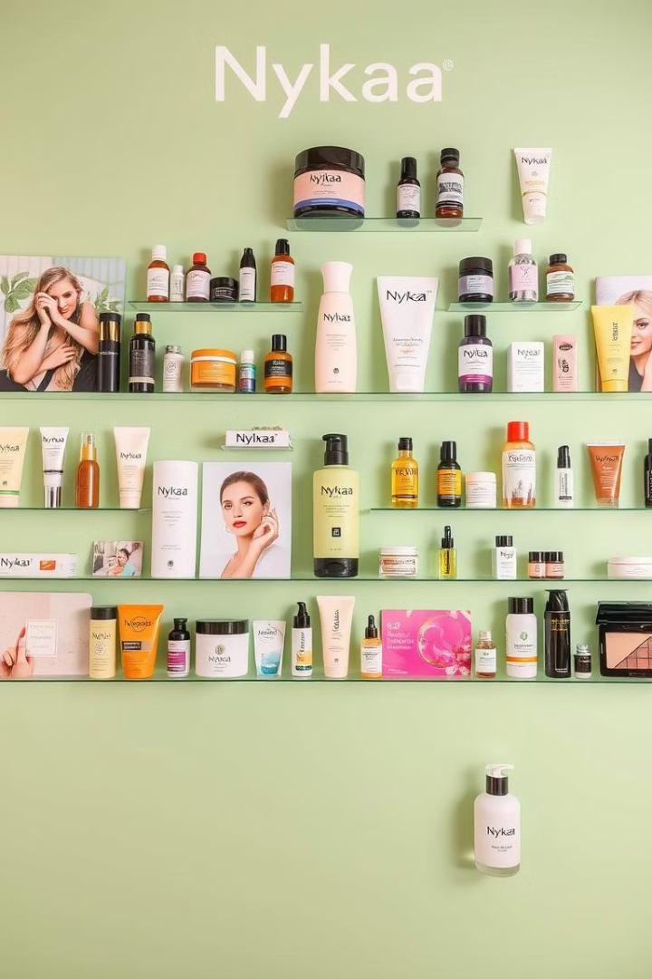




Nykaa's Product and Services
Beauty & Personal Care
Wellness Products
Offers a wide range of skincare, haircare, makeup, and other personal care products from leading brands and its own private label.
Includes health supplements, personal hygiene essentials, and other wellness products to cater to a holistic approach to health and wellbeing.
Fashion Products
Private Labels
Offers a curated selection of footwear, clothing, jewelry, and accessories for men and women, focusing on trend-driven and stylish pieces.
Nykaa's own product lines, such as Nykaa Cosmetics, Nykaa Naturals, Kay Beauty, and 20 Dresses by Nykaa Fashion, provide high-margin and exclusive offerings.

Slide 5
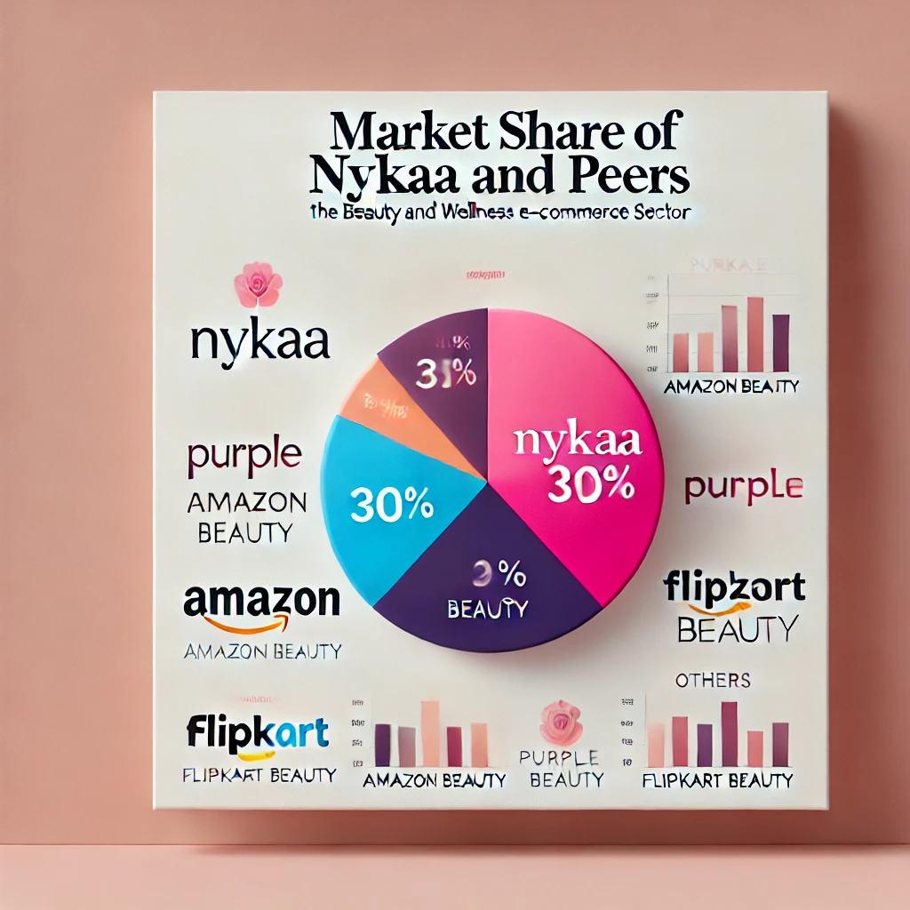

Nykaa's Business Model
Marketplace Model
Private Labels
Nykaa collaborates with third-party sellers, earning commissions on sales made through its platform, providing a wide range of products and brands to its customers.
Nykaa's own brand offerings generate high margins, establishing brand identity and differentiation in the market, offering unique and exclusive products.
Omnichannel Strategy
Combining online and offline retail, Nykaa provides a seamless customer experience with its e-commerce website and mobile app for online sales and physical presence with Nykaa Luxe and Nykaa On Trend stores.

Slide 6
Financial Analysis :
Metric | 2020 (March) | 2021 (March) | 2022 (March)
Revenue | 1767.53 | 2440.9 | 3773.94
Total Expenditure | 1681.82 | 2282.65 | 3612.22
EBITDA | 85.71 | 158.25 | 161.72
Other Income | 10.55 | 11.76 | 29.3
Interest | 46.24 | 32.29 | 47.3
Depreciation | 64.55 | 71.59 | 96.41
Profit Before Tax | -14.53 | 66.12 | 47.31
Tax | 8.47 | 4.48 | 6.02
Profit After Tax | -23.0 | 61.65 | 41.29
Net Profit | -23.27 | 61.55 | 41.08

Slide 7
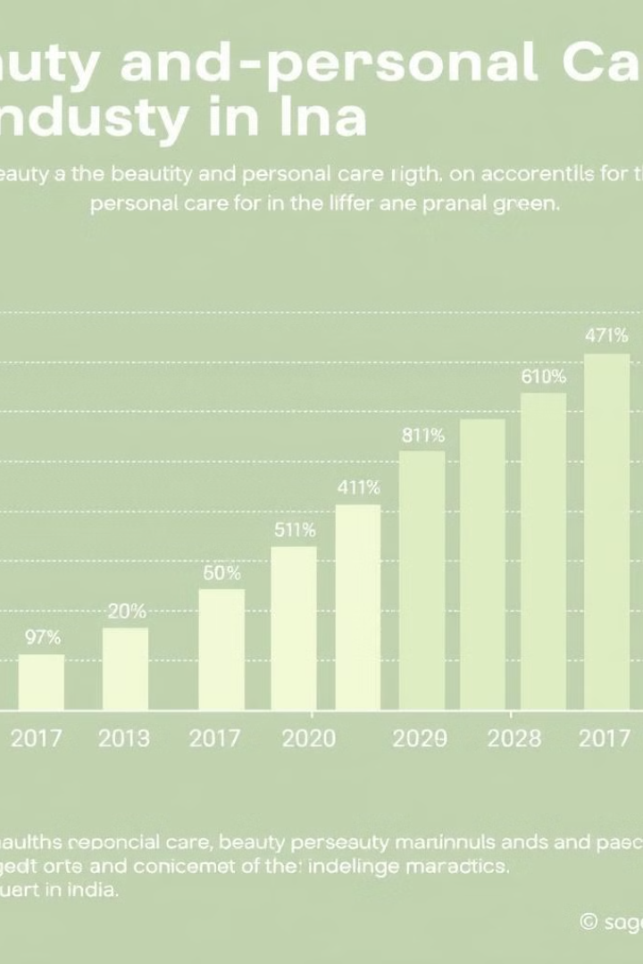
Key Ratios and Metrics
30%
Market Share
Nykaa holds a significant market share in the beauty and personal care sector, with a strong brand presence and loyal customer base.
10.5%
Industry Growth
The beauty and personal care sector is experiencing robust growth in India, with high consumer demand and rising disposable incomes.
54%
Revenue Growth
Nykaa demonstrates impressive revenue growth, outperforming the industry average, driven by its successful omnichannel strategy and strong product portfolio.

Slide 8
Nykaa's Pre-IPO Valuation Methodology
Comparable Company Analysis
Pre-IPO Fundraising Rounds
Nykaa's valuation was based on the Comparable Company Analysis (CCA) methodology, benchmarking its key financial metrics against similar companies in the e-commerce and beauty-tech sectors. This approach allowed for a relative valuation, comparing Nykaa to established players in the market.
Nykaa raised significant funding in the pre-IPO period, attracting investments from prominent venture capitalists and private equity firms. These fundraising rounds provided insights into investor confidence and the company's valuation trajectory.
NYKAA’S Pre-IPO Fundraising Analysis :
March 2021 : Amount Raised: ₹100 crore on revenue of ₹ 1800 crore that made post-round valuation ₹ 9000 crore
Revenue to Valuation Multiple (FY20): 4.8x
July 2021 : Amount Raised: ₹166 crore on revenue of ₹ 2400 crore that made post-round valuation ₹ 17500 crore
Revenue to Valuation Multiple (FY20): 7.1x

Slide 9
Nykaa's Valuation Compared to Peers
4.8x
3.99x
10x
Nykaa (FY20)
Purplle (FY20)
Flipkart (FY20)
Nykaa's revenue to valuation multiple was 4.8x in FY20. This signifies that investors were willing to pay a premium for the company's growth potential and strong market position.
Purplle, a competitor in the online beauty market, had a revenue to valuation multiple of 3.99x in FY20, indicating investor confidence in its growth trajectory. This reflects the competitive landscape and investor appetite for the beauty e-commerce sector.
Flipkart, a major e-commerce giant, had a revenue to valuation multiple of 10x in FY20, reflecting its dominance in the Indian e-commerce market. This provides context for understanding Nykaa's valuation in relation to a more established player.

Slide 10

Analyzing Nykaa's IPO Roadshow Presentation
1
Growth Strategies
2
Market Leadership
Nykaa's IPO roadshow highlighted its robust growth strategy, focusing on expanding its product offerings, strengthening its omnichannel presence, and leveraging technology for enhanced customer experience.
The presentation emphasized Nykaa's leading position in the Indian beauty and personal care market, highlighting its strong brand recognition, loyal customer base, and innovative product portfolio.
3
Future Expansion
Nykaa outlined its ambitious plans for future expansion, including venturing into new categories, expanding its geographical reach, and exploring new revenue streams. This signaled its commitment to long-term growth and diversification.

Slide 11

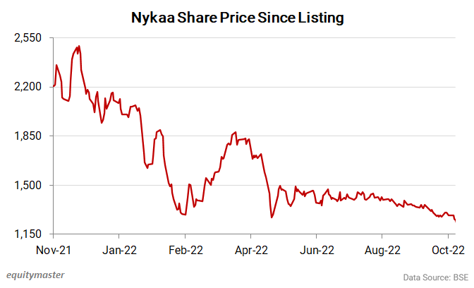



Investor Reaction to Nykaa's IPO
Initial Surge
Nykaa's IPO was met with strong investor enthusiasm, with the stock price surging on its debut. The IPO received overwhelming subscription, demonstrating strong market interest and confidence in the company's future prospects.
Market Volatility
Following the initial surge, Nykaa's stock price experienced some volatility, a common occurrence in the stock market. This volatility can be attributed to various factors, including market sentiment, broader economic conditions, and investor expectations.
Long-Term Potential
Despite the initial volatility, investors remain optimistic about Nykaa's long-term growth potential. The company's strong market position, brand reputation, and strategic expansion plans position it for sustained growth and value creation in the future.

Slide 12




Key Takeaways
Growth Potential
Nykaa's IPO offers investors exposure to the rapidly expanding Indian e-commerce and beauty market. The company's strong growth potential and strategic initiatives position it for continued success.
Competitive Landscape
The beauty and e-commerce landscape is becoming increasingly competitive. Nykaa's ability to navigate this competitive environment and maintain its market leadership will be crucial for its long-term success.
Profitability and Value Creation
Nykaa's path to profitability and sustained value creation will depend on its ability to manage costs, optimize operations, and deliver on its growth plans. Investors will be closely watching the company's performance in these areas.

Slide 13


Conclusion :
NYKAA’S IPO journey reflects its strategic business growth and investor appeal. Despite initial concerns about its high valuation, the company's consistent revenue growth, profitability, and market leadership in beauty and fashion e-commerce justified its premium pricing.
A notable highlight post-IPO was NYKAA’S bonus share issuance in November 2022, in a 5:1 ratio (five bonus shares for every one share held). This move signaled management’s confidence in the company’s future and aimed to reward shareholders by improving stock liquidity and making shares more affordable for retail investors.
Nykaa's long-term investment appeal is backed by its strong market position, expanding product categories, and successful omnichannel model. Its continued focus on innovation, brand partnerships, and international expansion strengthens its growth potential.
For investors ,The bonus issue and its valuation strategy demonstrate the company’s commitment to enhancing shareholder value, making it a promising investment for long-term wealth creation.

Slide 14
Thank You!

